Slide 1
Information session
January 18, 2022
Notes:
We are so pleased to have you joining us for today’s information session about the Financial Aid Payment Office!
This session will provide an overview of our workforce system, the many pieces that come together to allow us to serve employers and individuals in the Gulf Coast region, and specific information about what we look for in contractors. Our goal is for you to leave with helpful information, so there will be plenty of time at the end of this presentation for Q&A at the end.
Again thank you for being here.

Slide 2
Financial Aid payment office
Notes:
The subject of today’s information session is the Financial Aid Payment Office, which is a critical piece of our workforce system. We will discuss its purpose and function in detail later in this presentation.
But first, let’s dig into Workforce Solutions – who we are and what we do.

Slide 3
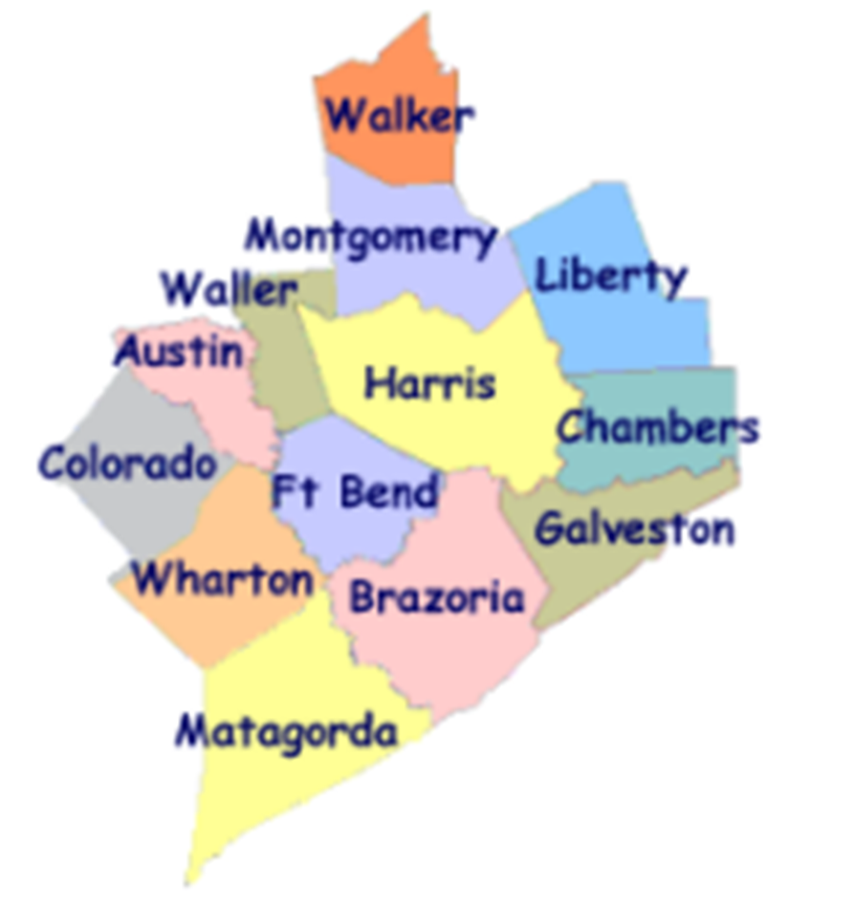
Workforce Solutions
ABOUT US:
Gulf Coast Workforce Board – Workforce Solutions is the public workforce system serving the 13-county Gulf Coast region
We elevate the economic and human potential of the Gulf Coast region by fulfilling the diverse needs of the employers and individuals we serve
What we can do:
List and fill open jobs, including HR consulting
Offer career advice and job placement assistance
Support individuals with their education and training needs
Provide work-based learning opportunities
Support families with early education financial aid
Assist individuals with disabilities with education and job opportunities
Notes:
The Gulf Coast Workforce Board and its operating affiliate Workforce Solutions are the public Workforce system in the 13-county Houston-Galveston region.
Business-led and community-focused, the Workforce Board sets the region’s Workforce agenda and the strategic direction for the Workforce Solutions system.
The Houston-Galveston Area Council (H GAC) is the Board’s staff, serving as the system’s corporate home office and providing management of and direction to sub-recipients that operate within the Workforce Solutions network.

Slide 4
Workforce Solutions
PURPOSE
To keep our region a great place to do business, work and live.
MISSION
We elevate the economic and human potential of the Gulf Coast region by
fulfilling the diverse needs of the businesses and individuals we serve.
VISION
Our region attracts and retains the best employers, affords everyone the dignity
of a job, remains vitally important to the global economy — and all within it are
thriving.
VALUES
We Are Employer-driven
We Care Passionately
We Take Responsibilities Seriously
We Imagine Possibilities
Notes:
Part of understanding who we are as a system, is knowing our purpose, mission, vision, and values.
Our purpose is to keep our region a great place to do business, work, and live.
PURPOSE
To keep our region a great place to do business, work and live.
MISSION
We elevate the economic and human potential of the Gulf Coast region by fulfilling the diverse needs
of the businesses and individuals we serve.
VISION
Our region attracts and retains the best employers, affords everyone the dignity of
a job, remains vitally important to the global economy — and all within it are thriving.
The values that guide our behaviors as we execute our purpose, mission, and vision are:
VALUES & BEHAVIORS
We Are Employer-driven
We Care Passionately We Take Responsibilities Seriously We Imagine Possibilities
Advocate for others Be accountable Seek multiple perspectives
Inspire hope Bring fresh thinking Follow up and follow through
Fuel progress Drive results Engage one another in making a difference

Slide 5
A meaningful impact
Notes:
We expect these efforts to result in more competitive employers, a better educated workforce, more and better jobs, and higher incomes.
Workforce Solutions helps employers meet their human resource needs and individuals build careers.
We deliver direct service to businesses and people throughout the region. Our system is all about making the labor markets that impact our region work more efficiently for employers and workers. We do this by identifying and filling imbalances or gaps between supply and demand in an effort to keep our region the best place to do business, work and live. Our entire system works to provide employers, individuals, educators, students, and parents with up-to-date and useful information on opportunities for growth, good wages, and future careers.

Slide 6
2021 Impact
24,600 employers and 428,000 individuals served
Spent at least $13.3 million on scholarships for more than 3,400 individuals in high-skill, high-growth occupational training
Supported nearly 22,000 families and 42,000 children with early education subsidies
Helped more than 69,800 individuals go to work
Raised the incomes of 32,747 by 20 percent or more
Helped 76.6% of individuals pursuing a post-secondary education attain a credential (certificate or degree)
Notes:
Workforce Solutions knows that our region is more than just a point on a map. It is the home of millions of people and the location of thousands of businesses. And the relationship between those two is what keeps our region bustling with activity and rich in promise. When we identify and pursue every opportunity to bring vibrancy to the labor market, we generate more promise and hope. Our region becomes a magnet for amazing businesses and amazing talent. People flock here for jobs and businesses rush for opportunities to grow. We become a place where businesses and people want to plant their roots because they see a bright future here. Abundance follows, and as a result, we become an even more important player in the world economy and all in our region thrive.
This philosophy has produced the following results over the past year (read bullets)

Slide 7
How We Do It
Notes:
Workforce Solutions creates this impact by helping employers meet their human resource needs and supporting individuals as they build careers.
We deliver direct service to businesses and people throughout the region.
Our system is all about making the labor markets that impact our region work more efficiently for employers and workers. We do this by identifying and filling imbalances or gaps between supply and demand in an effort to keep our region the best place to do business, work and live.
Our entire system works to provide employers, individuals, educators, students, and parents with up-to-date and useful information on opportunities for growth, good wages, and future careers.

Slide 8
Pieces of the System
Employer Service
Career Offices
Financial Aid Payment Office
Financial Aid Support Center
Texas Workforce Commission Integration Management Team
Youth Service – Next Gen
The Regional Team
Regional Quality Assurance Team
Staff Training & Development
Education Opportunity Consortium
Early Education Quality (Childcare)
Vocational Rehabilitation Services
Veteran Staff
Notes:
We know that individual’s job needs can best be met by meeting employers’ needs for a well-educated and well-trained workforce; therefore, the local workforce system has two principal components:
Our Employer Service division provides information and markets and sells service to employers.
Our Career Offices provide a pathway to an array of information, resources and opportunity for residents of this region.
Workforce Solutions is committed to being employer-driven -- you heard it mentioned when we covered our values. Employer service is the lead component in the delivery system, with employers as the primary customer. This is the case because it is the employers that drive the volume, diversity and timing of opportunities we can offer the individuals we serve.
Though we have two principal service components, our Workforce Solutions system has many interconnected pieces that must work together to deliver our services. The Board procures contractors for the operation of each of the pieces of the Workforce Solutions, which include (read bullets)

Slide 9
Financial aid payment office

Slide 10
What is the Financial Aid Payment Office?
Our Vision
A centralized accounting office responsible for making accurate and timely payments to vendors for authorized services and developing and maintaining vendor relationships.
Opportunities for Improvement
Technology Enhancements
Responsiveness and Availability
Timely payments
Notes:
Workforce Solutions offers financial aid to help individuals get the skills and credentials they need to get a job, keep a job or get a better job. The Financial Aid Payment Office oversees the distribution of this financial assistance.
Our vision for the payment office is a centralized accounting office responsible for making accurate and timely payments to vendors for authorized services and developing and maintaining vendor relationships. This office works directly with the system partners and Board staff to provide up-to-date financial information concerning the availability of financial aid for area customers.
As with most areas in our system there are several opportunities for improvements. We would like to see technology enhancements made towards our vendor portal by providing more information online and better online tools for vendor partners in our network. Additionally, we would like to improve our response times to vendor inquiries and system partner requests. Finally, with the large volumes of transactions the unit is responsible for processing, we must ensure vendors invoice in accordance with our policies and are paid timely.

Slide 11
Financial Aid
Types of Financial Aid
Education scholarships
Early education assistance (childcare)
Transportation
Work related expenses
Work-based learning opportunities
Notes:
Workforce Solutions provides financial aid to support people’s ability to work, search for work or train for work. Financial aid falls into the following categories:
Education scholarships (tuition and fees, books and supplies)
Childcare assistance (provider payments and other childcare supportive services)
Transportation (expenses related to looking for work, beginning work, or getting to school)
Work related expenses (clothing, tools and equipment, licenses, documents)
Work-based learning opportunities (Work experience wages, registered apprenticeships, and on-the-job training reimbursement

Slide 12
Management
Functions
Vendor relationships and the Vendor Network
Financial Aid payments
Fraud and overpayment recovery
Forecasting and funds managements
Financial Aid Management System (FAMS)
Cash substitutes oversight
Workforce System Integration
Notes:
The Payment Office oversees many functions for the Board. Primary functions include:
Managing our Vendor Relationships and the Vendor Network. This include procuring new vendors and new types of financial aid assistance.
Making timely and accurate financial aid payments. This is essential to provide exceptional customer services and accurate reporting.
Responsibility for fraud and overpayment recovery.
Advanced forecasting and funds management to coordinate the workforce system to maximize assistance to customers
Is responsible for administering the Financial Aid Management System (FAMS). This system is used to track commitments for customers receiving financial aid.
Procuring cash substitutes for items such as bus passes, gift cards, gas bards, and maintain the inventory and monitoring the career office use of the times.
Workforce System Integration – Working with our system partner to address their needs, provide information, solutions, and technical assistance. This includes ensuring system partners conform to Workforce Solution policies and meet deadlines.

Slide 13
Current Operations
The payment office receives $3.6 million to support 40 staff and other operational costs.
Staffing:
11 Vendor and Customer Services
8 Accounts Payable
5 Management
4 Administrative
3 Compliance
3 Funds Management and Data
3 Treasury
2 System and Support
1 Quality Assurance
Notes:
The payment office currently receives 3.6 million dollars to support 40 staff and other operational costs. The staffing for the unit currently includes:
11 Vendor and Customer Services
8 Accounts Payable
5 Management
4 Administrative
3 Compliance
3 Funds Management and Data
3 Treasury
2 System and Support
1 Quality Assurance

Slide 14
A Look at the Data
Service Volume
The Payment Office processed over $203 million in financial aid payments during FY21 and current projections show us exceeding $300 million in FY22.
Quantities:
Number of licensed childcare providers in network – 1,800
  Average number of childcare providers paid weekly – 1,400
  $4 to $6 million in payments processed weekly
Number of educational and work-based learning vendors in network – 400
  $1 to $2 million in payments processed monthly
Average amount of cash substitutes distributed monthly – $6,000
Notes:
The Payment Office processed over $203 million in financial aid payments during the 2021 fiscal year and current projections show us exceeding $300 million in FY22.
Quantities:
Number of licensed childcare providers in network – 1,800
Average number of childcare providers paid weekly – 1,400
$4 to $6 million in payments processed weekly
Number of educational and work-based learning vendors in network – 400
$1 to $2 million in payments processed monthly
Average amount of cash substitutes purchased monthly – $6,000
Bus Passes, Gift cards, gas cards, and other cash substitutes (normally one time, but might be reoccurring)

Slide 15
Questions
Notes:
What questions can we address for you today?

Slide 16
What’s Next

Slide 17
Workforce Solutions
Contracting With Us
An RFP will be extended in the coming weeks.
If your contact information changes, please reach out to Deborah Duke (Deborah.duke@wrksolutions.com) to share updates.
For more information about Workforce Solutions, visit www.wrksolutions.com.

